Slide 1
Actor - Critic
Dr. Prashant Aparajeya

Slide 2
Actor-Critic (AC) – The Foundation
Actor-Critic is a hybrid method that combines:
Actor: Learns the policy (i.e., what action to take in each state).
Critic: Estimates the value function (e.g., how good the state or state-action is).
It's a policy gradient method where the critic helps reduce the variance in the policy updates.

Slide 3
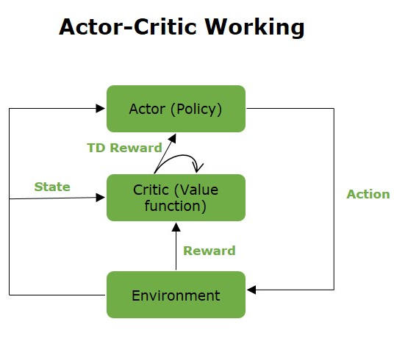
How it works
The actor proposes an action based on current policy.
The critic evaluates how good that action was by estimating the value function (e.g., using TD error).
The actor updates its policy in the direction suggested by the critic.

Slide 4
Example
Let’s say you're training an agent to play CartPole:
Actor suggests: “Push cart left.”
Critic says: “Based on recent rewards, that was a good move (positive TD error).”
Actor becomes more confident about pushing left in that state.

Slide 5
A2C (Advantage Actor-Critic)

Slide 6
A2C (Advantage Actor-Critic)
What is it?
A2C is a synchronous, optimized version of the basic Actor-Critic method:
"Advantage" refers to using advantage function A(s,a) instead of the raw value function.

Slide 7
Formula
The policy gradient is computed using:
Where:
A(s,a)=Q(s,a)−V(s)
This tells you how much better an action is compared to the average, which helps focus learning.

Slide 8
Key Features
Runs synchronously (i.e., updates are batched and processed in a coordinated way).
Reduces variance in learning using the advantage function.

Slide 9
Example: CartPole
Agent picks action "left".
Advantage is computed (e.g., A(s,a) = +2.0).
Actor updates to increase probability of that action.
Critic learns to better estimate V(s).

Slide 10
A3C (Asynchronous Advantage Actor-Critic)

Slide 11
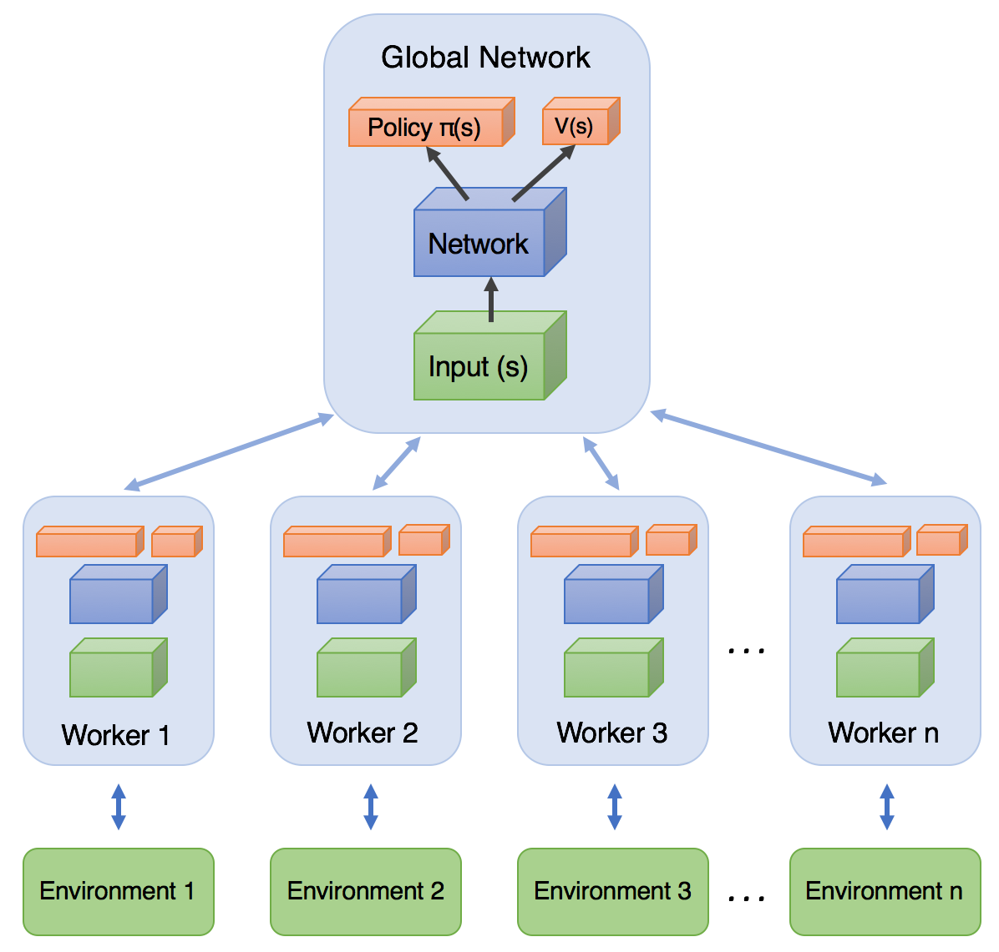
A3C (Asynchronous Advantage Actor-Critic)
What is it?
A3C is a parallelized version of A2C:
Multiple agents (workers) interact with their own copy of the environment.
Each worker has its own copy of the network.
Gradients from workers are asynchronously applied to a shared global model.

Slide 12
Key Features
Asynchronous training → helps decorrelate experiences.
Parallelism → speeds up learning.
Each agent learns from different parts of the state space.

Slide 13
Why it's better than A2C?
A3C allows faster convergence and better exploration, especially in complex environments.

Slide 14
Example: Doom AI
In a 3D game like Doom, different A3C workers may explore different rooms or strategies.
They share their gradients with the global model,
Which leads to robust learning even in a highly non-stationary, high-dimensional space.

Slide 15
SAC (Soft Actor-Critic)

Slide 16

SAC (Soft Actor-Critic)
What is it?
Soft Actor-Critic (SAC) is a modern, off-policy, entropy-regularized actor-critic algorithm that aims to:
Maximize expected reward
Plus maximize entropy (i.e., act more unpredictably or explore more)
Where H is entropy, and α (temperature) balances reward and entropy.

Slide 17
What’s the Role of α
The temperature parameter α controls how much weight entropy has:
High α → More exploration (entropy is prioritized).
Low α → More exploitation (reward dominates).
SAC often uses automatic temperature tuning:
It learns α to match a target entropy (e.g., encourage a desired level of policy randomness).

Slide 18
Key Features
Off-policy: Uses replay buffer.
Stochastic policy: Uses continuous action distributions.
Entropy maximization: Encourages exploration.
Excellent for continuous control tasks (e.g., robotics).

Slide 19
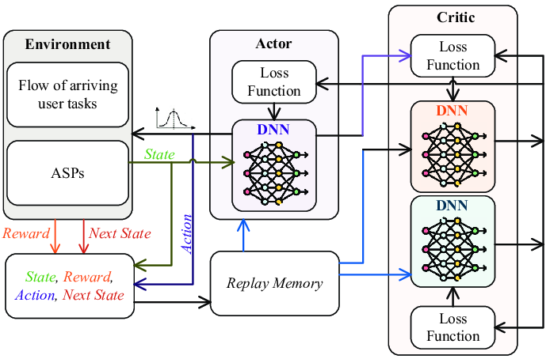
Architecture
Two critics (Q-functions) → helps reduce overestimation bias.
One actor (stochastic policy).
A value target network (optional, depending on implementation).

Slide 20
Example: Robotic Arm
A robotic arm using SAC will:
Learn how to pick up objects effectively.
Simultaneously explore new movements due to entropy regularization.
Learn efficiently from past experiences (off-policy).

Slide 21
Example: 2D robot learning to walk
Traditional RL: Learns a path and sticks to it (can get stuck in a local optimum).
Entropy-regularized RL (e.g., SAC): Tries multiple walking styles (e.g., longer strides, angled arms) → better exploration → finds more optimal gait.

Slide 22
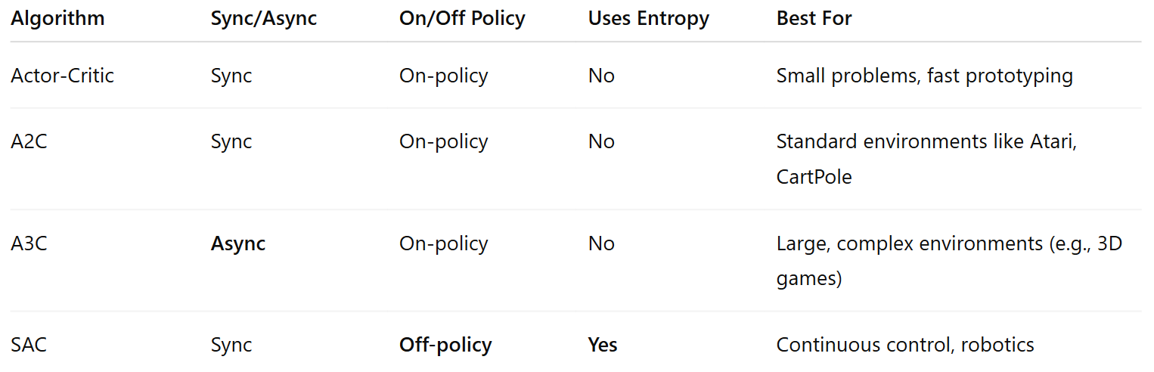
Comparison Table

Slide 23
When to Use What?
Simple RL problem (e.g., gridworld, CartPole)? → A2C is fine.
Complex environment, want parallel exploration? → A3C.
Continuous action space + high performance needed? → SAC.
Want fast, intuitive experimentation? → AC or A2C.

